Slide 1
CSE 720 Project Presentation Group - 5
Course - Computer Graphics and Animation Faculty - Dr. Md. Ashraful Alam (ASA) Team Members:
Name | ID
Mirza Ahmad Shayer | 22273008
Sushana Islam Mim | 22273001
Md. Abrar Ur Rahman | 24166047
Salman Sadat Nur | 22273011

Slide 2
Cube Catcher
A 2D platformer game where the player will have to catch cubes of many various types to score points. The player can keep catching cubes for increasing the points. Different cubes have different points to them.
Game is an endless loop, the higher the score, the better the player.
There are hazardous objects that the player needs to avoid, else the players health will decrease. Some hazardous objects are obstacles, enemies and other cubes.

Slide 3


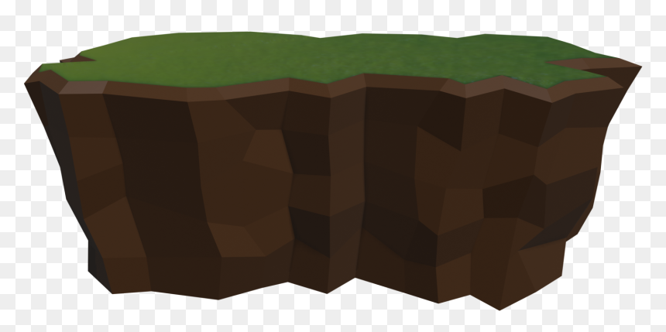

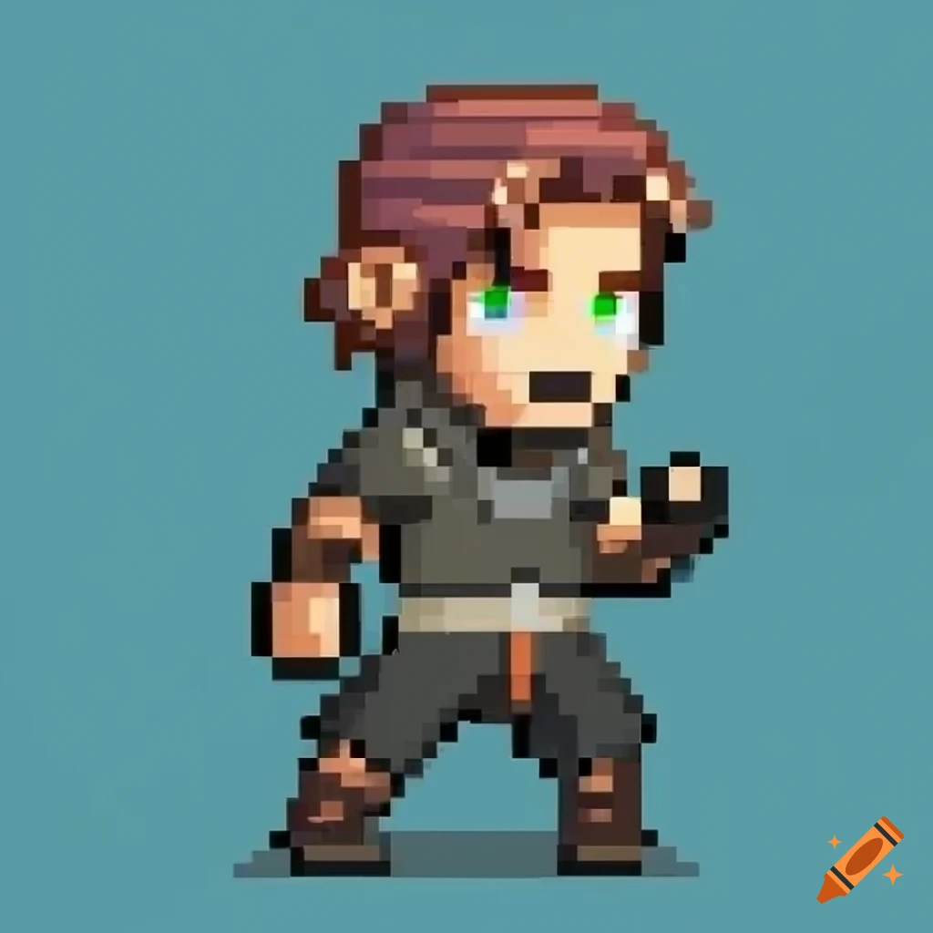
A rough example image of the game

Slide 4
Abstract
In the era of video games - platform games or platformers have defined an unforgettable picture of fun, excitement and challenge. During the 1980’s platformers were popular games in arcades. People would go to play them in large crowds. “Sonic” and “Mario” were the most popular ones. Followed by “Donkey-Kong”, “Burger-Time” and many others that followed the trend. Even today platformers are still popular amongst people of all ages. Many indie studios make different kinds of platformers today.
A platform game is where the video game character or sprite is controlled by the player via an input device - keyboard, joystick, mouse or gamepad. The player moves the character around to collect tokens or collectables, dodge hazardous objects and enemies and make it to the end of the level. Some platformers are an infinite loop where the main aim is to get the highest score while others are level based. Levels get harder the player progresses further. Platformers are either 2d or 3d.

Slide 5
Abstract - Continued
Platform games have different types - most popular are tile-based (pure or smooth), bitmask or vectoral. In platform games there are various game assets or objects within the gaming world. Character movements are considered when designing video games. Most often they simply move and jump while other games have more functionalities.
For our video game - a character will catch various cubes in an endless loop jumping from platform to platform and avoiding dangerous objects. The games technical summary is discussed below in great detail. With system architecture, working principle, methodology, and tools used. Followed by a detailed work-plan then conclusion and future work.

Slide 6
Technical summary
Below the technical summary of the project is defined in detail. Below are the following topics that are covered in next slides.
System Architecture
Working Principle
Methodology
Tools Used

Slide 7
Technical Summary: System Architecture
For video games the architecture is similar to software. The 5 components are present in the game:
Graphics Engine
Sound and Audio Engine
Rendering and Vision Input Engine
I/O Devices - Keyboard, Mouse
DLL files and Drivers/Device APIs
All of these elements combined will give game playability to the maximum.

Slide 8
Technical Summary: System Architecture - Continued
→Graphics Engine: Software with an application program that helps to draw graphics on computer's display. Also makes game's scenes clear and run smooth.
→Sound/Audio Engine: Consists of algorithms for dealing with sound and in-built programs are written to handle the sound effects in the game. Abstraction APIs, like Open-AL, SDL Audio, X-Audio 2, Web Audio, etc.
→Rendering and Vision-Input Engine: Along with vision input system produces 3D animated graphics, using different techniques, like rasterization and ray-tracing. Direct3D and OpenGL or DirectX.

Slide 9
Technical Summary: System Architecture - Continued
→I/O Devices: Input Devices - inputting the data, Output Devices - generate the finished product of machine processing. Peripheral devices like mouse, keyboard, joysticks, gamepads and monitors.
→DLL files and Drivers/Device APIs: A DLL (Dynamic Link Library) file - type of file which includes instructions written in the form of programs which can be called or used by other programs for performing certain tasks. API (Application Programming Interface) lets the developers to create any application which can ultimately interact with hardware devices.

Slide 10
Technical Summary: Working Principle
For this 2D-platformer game the key components and systems are given below.
→Game Objects and Components: Represent entities within the game world, such as characters, obstacles, platforms, and collectibles. Sprite Renderer for visuals, Rigidbody2D for physics simulation, Collider2D for collision detection, and scripts for behavior and interactions.
→Character Controller: Player character is controlled using a character controller script that handles user input (e.g., keyboard, gamepad). Controller script typically applies forces or changes the position of the character based on input.

Slide 11
Technical Summary: Working Principle - Continued
→Physics Simulation: Unity's 2D physics engine simulates interactions between game objects, including collisions, gravity, friction, and momentum. Rigidbody2D components are used.
→Level Design: Levels are designed using Unity Scene Editor, where designers place and arrange game objects to create platforms, obstacles, hazards. Puzzles, combat and pacing are put together.
→Visuals and Art Assets: 2D art assets such as sprites, animations, backgrounds, and particle effects are created or imported into Unity to give the game its visual style and atmosphere. Visual effects such as lighting, shadows, shaders, and post-processing effects can be applied.
→Sound and Music: Audio assets such as sound effects, music tracks, and voiceovers are added to the game to provide auditory feedback and enhance immersion.

Slide 12
Technical Summary: Methodology
Initial Planning:
Define the core gameplay mechanics, such as catching cubes for points and avoiding hazardous objects.
Determine the types of cubes and hazards that will be present in the game, along with their respective properties (e.g., point values for cubes, effects of colliding with hazards).
Sketch out the basic level design layout, considering the placement of cubes, hazards, and any additional features.
Prototype Development:
Create a basic prototype in Unity to implement the core mechanics and test the gameplay loop.
Implement player movement controls, cube spawning, cube collection mechanics, and hazard collision detection.
Set up a scoring system to track points earned by the player for catching cubes.
Implement basic UI elements to display the player's score and health.
Iterative Development:
Iterate on the prototype based on playtesting feedback, making adjustments to gameplay mechanics, level design, and visual elements.
Refine the spawning mechanics for cubes and hazards to ensure a balanced and engaging gameplay experience.
Fine-tune the difficulty curve to gradually increase challenge as the player progresses.

Slide 13
Technical Summary: Methodology(Continued)
Art Asset Creation:
Design and create graphics assets for the game using tools like Adobe Photoshop, GIMP, or Aseprite.
Create sprite sheets for the player character, different types of cubes, hazardous objects, and background elements.
Animate the player character and any dynamic game elements as needed.
Audio Asset Creation:
Produce sound effects for various game events, such as cube collection, hazard collisions, and background ambiance.
Compose or select background music tracks that complement the game's theme and atmosphere.
Integration and Polish:
Integrate the art and audio assets into the Unity project, replacing placeholder assets used during prototyping.
Add visual effects and particle systems to enhance the game's aesthetics and feedback mechanisms.
Implement additional features such as screen transitions, level progression, and game over conditions.
Testing and Debugging:
Conduct thorough playtesting sessions to identify bugs, glitches, and areas for improvement.
Debug issues related to gameplay mechanics, collision detection, performance optimization, and user interface functionality.
Iterate on the game based on testing feedback, addressing any issues discovered during the testing phase.

Slide 14
Technical Summary: Tools Used
Game Engine: Unity
Graphics Tools: Adobe Photoshop, Aseprite
Audio Tools: Audacity
Version Control: Git (GitHub)
Programming Language: C#

Slide 15
Work Plan
1. Conceptualization Phase:
Define the core concept, theme, and gameplay mechanics of the game.
Create a detailed game design document (GDD) outlining characters, levels, controls, UI, audio, etc.
Brainstorm and sketch initial ideas for characters, environments, and level designs.
2. Pre-production Phase:
Set up Unity project and integrate with GitHub for version control.
Create project structure and organize folders for scripts, sprites, audio, etc.
Finalize the game design document based on feedback and additional brainstorming.
Set up project management tools (e.g., Trello, Asana) for task tracking and team collaboration.

Slide 16
Work Plan (continued)
3. Prototyping Phase:
Develop a basic prototype of the game mechanics using placeholder assets in Unity.
Test the prototype internally to evaluate gameplay mechanics, controls, and overall feel.
Gather feedback from playtesters and iterate on the prototype to address any issues or concerns.
4. Production Phase:
Begin creating artwork using Adobe Photoshop and Aseprite for characters, environments, and UI elements.
Implement level designs in Unity, including platforms, obstacles, enemies, and interactive elements.
Program gameplay mechanics, player controls, enemy behavior, and game physics in C#.
Integrate audio elements using Audacity, including background music, sound effects, and voiceovers.
Continuously playtest the game to identify and fix bugs, and to ensure a smooth player experience.
Optimize performance and memory usage in Unity to ensure the game runs smoothly on target platforms.

Slide 17
Work Plan (continued)
5. Polishing Phase:
Fine-tune gameplay mechanics, level designs, and difficulty balancing based on playtesting feedback.
Polish artwork, animations, and UI elements to enhance visual appeal and usability.
Implement additional features or content to enrich the gameplay experience.
Perform thorough testing to ensure all aspects of the game are functioning correctly and to fix any remaining bugs.
6. Release Preparation Phase:
Create promotional materials, including screenshots, and marketing assets.
Prepare the game for distribution on various platforms, including PC and mobile devices.

Slide 18
Work Plan (continued)
7. Post-release Phase:
Monitor player feedback and reviews to identify areas for improvement or potential updates.
Address any post-release issues or bugs that may arise.
Consider developing and releasing additional content, updates, or patches based on player feedback.
8. Documentation and Reflection Phase:
Document the development process, including challenges faced, lessons learned, and successful strategies employed.
Conduct a post-mortem analysis to evaluate the project's success and identify areas for improvement in future projects.
Archive project files, assets, and documentation for future reference or potential reuse.

Slide 19
Conclusion
Cube Catcher is a platformer game that combines classic elements with modern mechanics, offering an engaging and dynamic experience for players of all ages. The game features endless looping, diverse cube types, and hazardous obstacles, paying homage to classics like "Sonic" and "Mario." The future of the game is promising, with plans to introduce new gameplay mechanics, multiplayer integration, level editing tools, and enhanced visuals and audio. The development team is committed to fostering a vibrant community and ensuring continued enjoyment for players.

Slide 20
Future Work
Game Development Goals:
• Expand gameplay mechanics and integrate multiplayer functionality.
• Create a user-friendly level editor tool.
• Optimize for various platforms and devices.
• Enhance visuals and audio with advanced rendering techniques and high-quality sound design.
• Encourage community features like leaderboards, achievements, and forums.
• Regular updates and content releases.
• Partner with influencers and streamers for promotion.
• Explore integration with emerging technologies like VR or AR for innovative gameplay experiences.

Slide 21
References
https://www.studytonight.com/3d-game-engineering-with-unity/game-development-architecture
Minkkinen, T. Basics of Platform Games. 1 January, 2016. URL - https://core.ac.uk/outputs/80991297?source=oai
https://medium.com/@josselin.querne/an-explanation-of-different-game-design-approaches-12b0937c8ebd
https://www.gameinformer.com/b/features/archive/2011/07/14/why-the-platformer-still-matters.aspx
https://www.gamedev.net/tutorials/programming/general-and-gameplay-programming/the-guide-to-implementing-2d-platformers-r2936/
https://gamedevacademy.org/how-to-build-a-complete-2d-platformer-in-unity/

Slide 22
Thank You
Any Questions?

